Slide 1
Detailed Overview of “over the counter pill”
Specifications: US, [8/1/19-8/1/20]
Ashley Kong 10/12/20

Slide 2
Initial Note
There will be no related queries for initial search term “self abortion” and “self-induced abortion”
This can be checked in both the API and the Google Trends Site
What does this mean?
Broad initial search terms

Slide 3
Our Goal
What is our main goal?
To find and highlight how women are experiencing difficulties accessing abortion resources/ being restricted from obtaining abortions potentially to the point where they would resort to self abortion
Steps:
1. Start with “over the counter pill” as initial search term [level 0]
2. Find related search terms [level 1, 2, .. etc.]
3. Remove extraneous search terms/ Cross-check search terms from API with the Google Trends site
4. Create tree visualization for relevant search terms
Add relative search volume to trees
5. Identify which terms deliver the deepest tree into topic of interest (abortion)
6. Additional step: check search terms for different time periods [1 year, 3 years, 4 years, etc.]
Notes:
Steps 5 and 6 are future steps

Slide 4
Step 1: Start with “over the counter pill” as initial search term [level 0]
For this example, related queries with a relative search volume of 0.04 were included

Slide 5
Step 2: Find related search terms [level 1, 2, .. etc.]
‘morning after pill over the counter’
‘best over the counter weight loss pill’
‘best over the counter diet pill’
‘pill identifier’
‘plan b pill’
‘morning after pill’
‘what is the best diet pill over the counter’
8.‘viagra pill’
9. ‘abortion pill’
10. ‘what is the best over the counter weight loss pill’
11. ‘water pill over the counter’
12. ‘best over the counter sleeping pill’
13. ’over the counter yeast infection pill’
14. ‘yeast infection pill’

Slide 6
Step 2: Remove extraneous search terms
‘morning after pill over the counter’
‘best over the counter weight loss pill’
‘best over the counter diet pill’
‘pill identifier’
‘plan b pill’
‘morning after pill’
‘what is the best diet pill over the counter’
8.‘viagra pill’
9. ‘abortion pill’
10. ‘what is the best over the counter weight loss pill’
11. ‘water pill over the counter’
12. ‘best over the counter sleeping pill’
13. ’over the counter yeast infection pill’
14. ‘yeast infection pill’
Notes:
Terms in red are those that were chosen to be removed

Slide 7
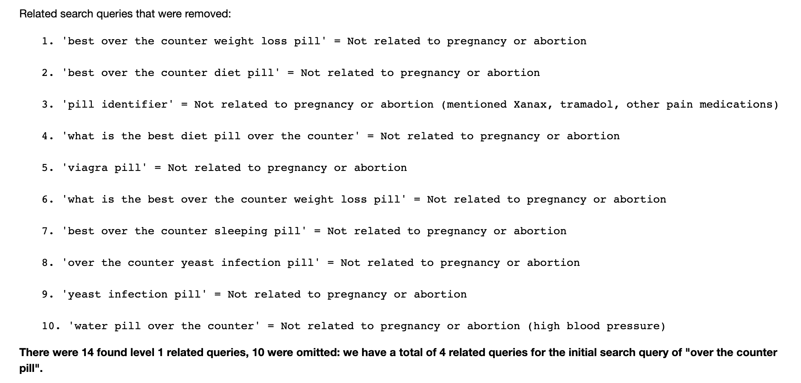
Step 3: Remove extraneous search terms

Slide 8
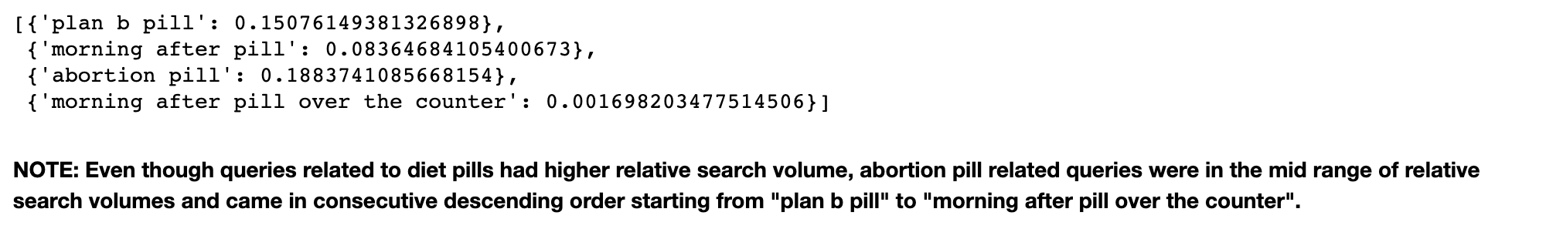
Step 2: Find related search terms [level 1, 2, .. etc.]
Relevant search queries

Slide 9
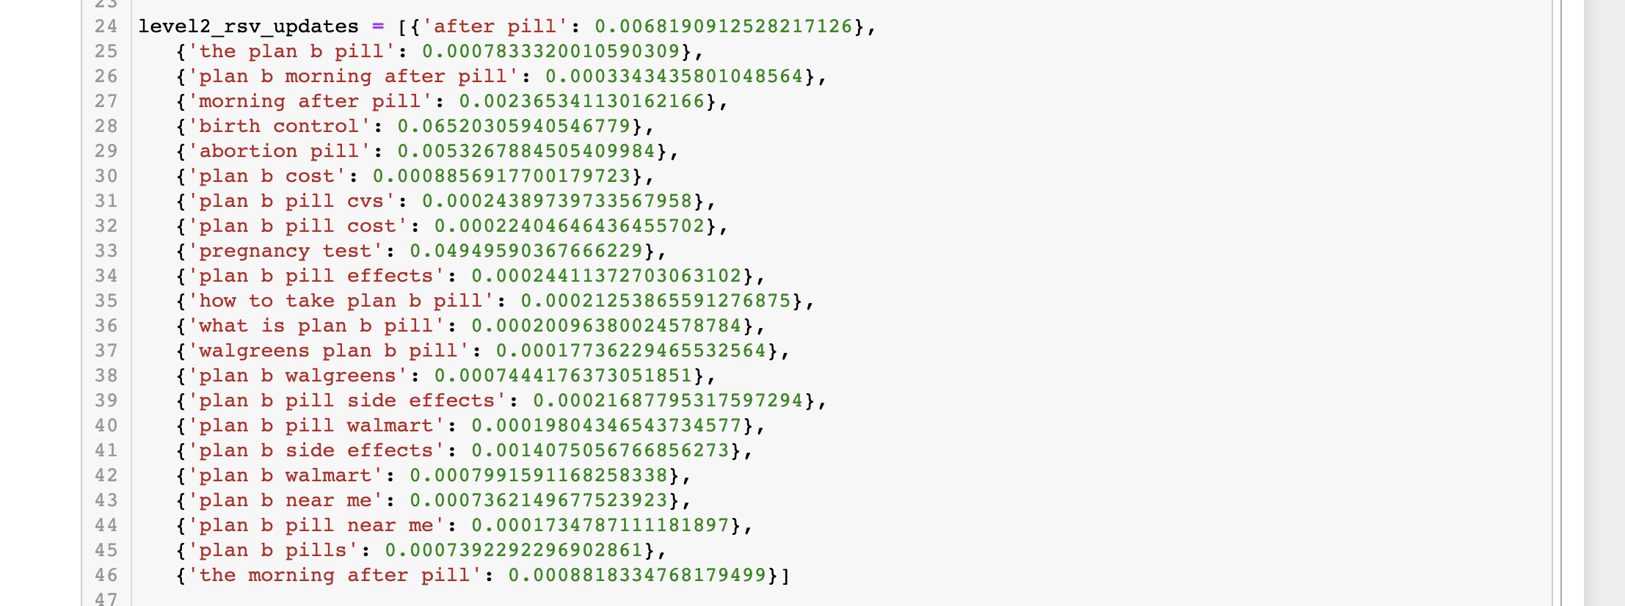

Step 3: Remove Extraneous search terms
‘plan b pill’ (level 2)
Many related queries but many have low relative search volume
In order to reduce tree fanout, we assign cut-off of 0.04 for relative search volume

Slide 10
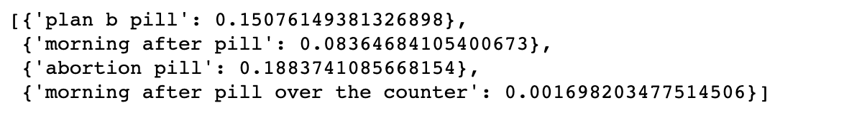
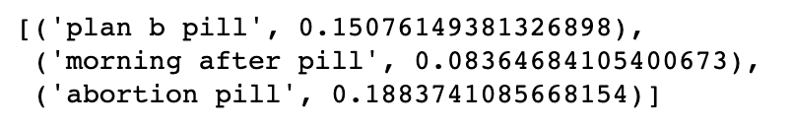
Step 2: Edit original related search terms
‘over the counter pills’ (level 1)

Slide 11
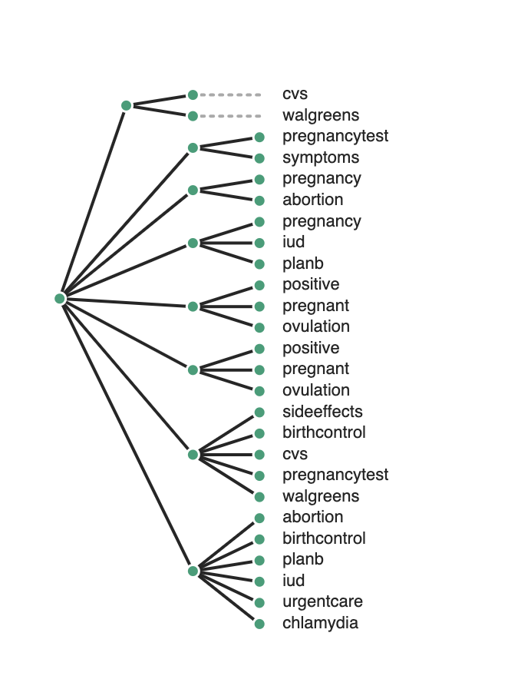
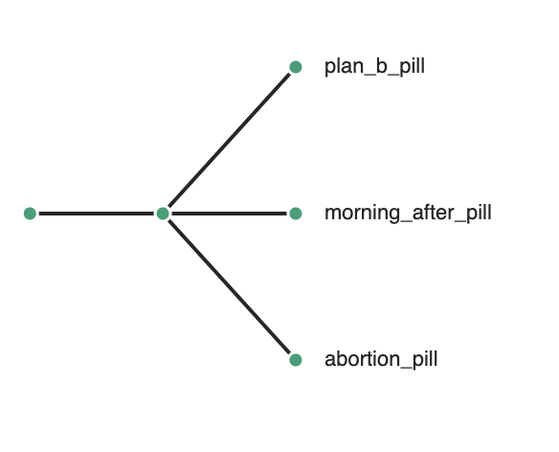
Step 4: Make Tree Visualization
NOTE: ToyTree graph is useful if we want to look at the level 1 queries and the final level queries

Slide 12
Step 4: Make Tree Visualization
Currently using the Graphviz tree visualization package
Over the counter pill tree
NOTE: Visualization was too large to fit on slide page
Notes:
Level 0: over the counter pill
Level 1: plan b pill, morning after pill, abortion pill
Plan b pill (looking from the perspective of a pregnant individual) [plan b is a specific kind of morning after pill, not considered an abortitative pill, take 72 hours after having sex and it will stp the egg from being fertilized, so it is technically not a abortization pill, because fertilization hasn’t occured]
Plan b pill is more official term for morning after pill
When people look for the plan b pill it’s usually from the perspective of a potentially pregnant individual who wants to clarify whether or not they are actually pregnant, where can I get this form of birth control
Morning after pill (looking for the resources to obtain the perspective of potentially pregnant)
When people look for over the counter pill and the morning pill they are looking more for where can they go to get the morning after pill
Abortion pill (similar pattern to plan b pill, perspective of pregnant individual, start to see abortion/miscarriage related terms)
People look for planned parenthood, pregnancy symptoms (so we are looking at perspectives of potentially pregnant individuals who are searching for planned parenthood to get these resources/find out whether or not they are pregnant/ finding out what they need to know if they want to get an abortion)
If we look at over the counter pill, the term with highest relative search volume is “pregnancy test” (ie. people want to know if they are pregnant/ if they have a positive pregnancy test)
When people search for over the counter pill, it appears that people have confusion between whether or not they are pregnant/ if they can take the morning after pill versus the abortion pill)
We see that when people search for over the counter pill they are either wanting to know whether or not they are actually pregnant and where they can get resources to either check or get the morning after pill (plan b pill/ morning after pill) OR they are more of the perspective that they know they are pregnant and want to search for the resources of either how they can get an abortion/ potential confusion as to whether they should take the abortion pill versus the plan b pill

Slide 13
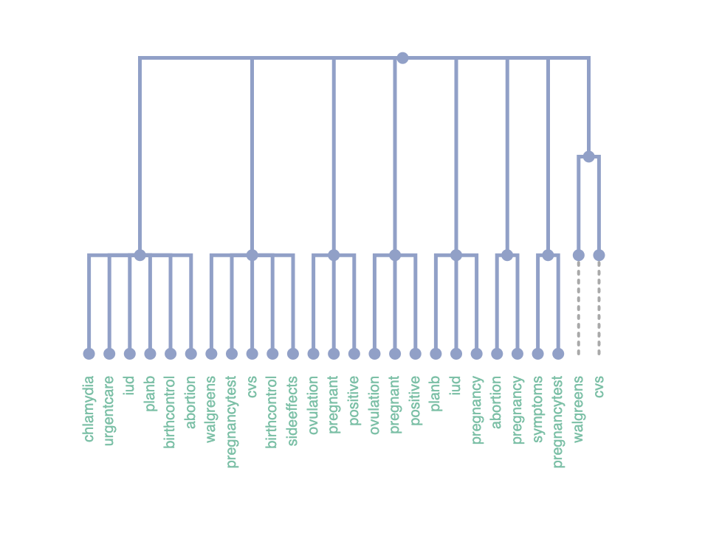
Step 4: What did we find?
For an initial search term of “over the counter pill”:
By the level 3 queries we start to see queries related to abortion, miscarriage, pregnancy, and iud’s
Many extraneous search queries for pills were for pain-related/ other health related issues
Queries that resulted in “cvs” or “walgreens” led to unrelated queries
The 5 year span from 2015-2020 is when we see “over the counter pill” have related search terms dealing with abortion pills

Slide 14
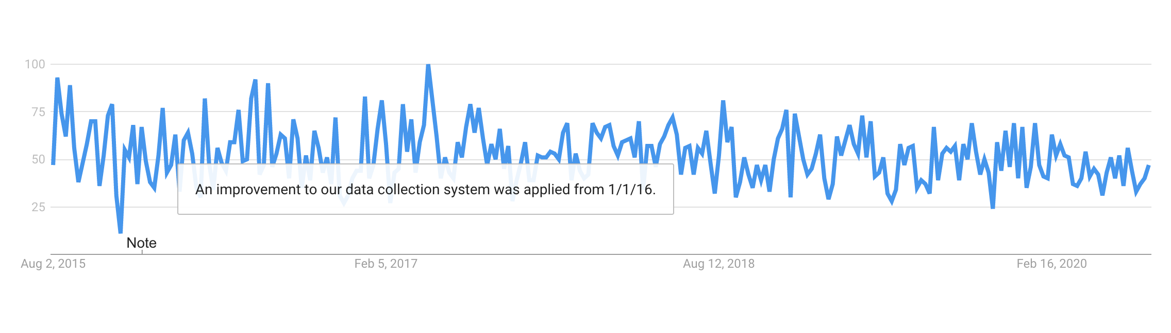
August 1, 2015 - August 1, 2020
On the Google Trends site, there is an indication that Google made changes to how they were collecting data for the site start in 2016

Slide 15
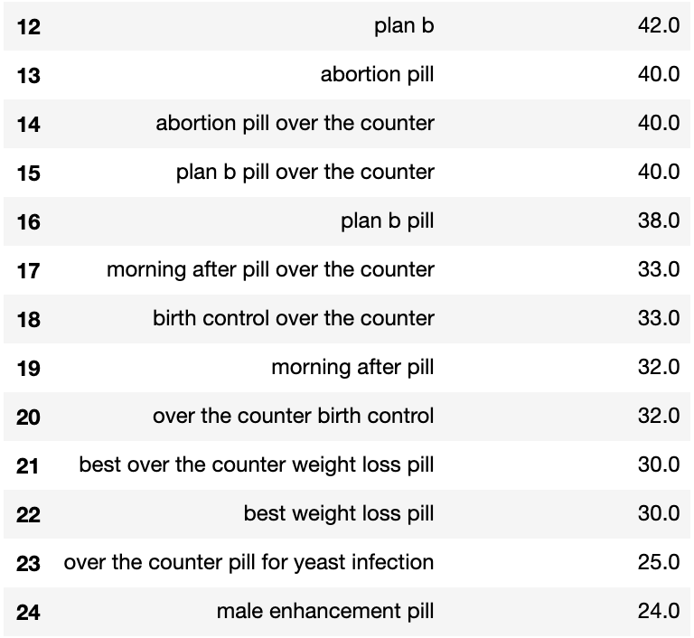
August 1, 2015 - August 1, 2020
The 5 year range 2015 - 2020 saw the introduction of abortion/abortion-associated related search terms

Slide 16
Issues to Keep in Mind
If initial search terms are too niche, Run_Simulation_Code will have a NoneType error when pulling data from the API because there isn’t enough information for the given region/given search term
The day specification for start and end date is volatile, it is important to keep these values the same
The Google Trends Site utilizes random samples for each query you input, you are not guaranteed to get the same result even if you search for the same term and date period multiple times
There may be an issue with pulling the related queries as initial search terms every time we run Run_Simulation_Code, it would be better to get all the levels at once

